Slide 1


[Social Buzz]

Slide 2


Today's agenda
Project recap
Problem
The Analytics team
Process
Insights
Summary

Slide 3


Social Buzz is a faster-growing technology
That needs to adapt quickly to its global scale.
Accenture has begun a 3 month POC focusing on
These tasks:
Project Recap
An audit of Social Buzz’s big data practice
Recommendations for a successful IPO
Analysis to find Social Buzz’s top 5 most
popular categories of content.

Slide 4


Problem
over 100,000 posts per day
36,500,000 pieces of content per year!
But how to capitalize on it when there is so much?
Analysis to find Social Buzz’s top 5 most popular categories of content.

Slide 5




Andrew Fleming
Chief Technical Architect
The Analytics team
Marcus Rompton
Senior Principle
Mahmoud Hassan
Data Analyst

Slide 6

Process
1
Understanding Data
2
Data Cleaning
3
Data Modeling
4
Data Analysis
5
Uncover Insight

Slide 7


Insights
16
Unique Categories
1897
Reactions To “Animal” Posts
JAN
month with the most posts

Slide 8
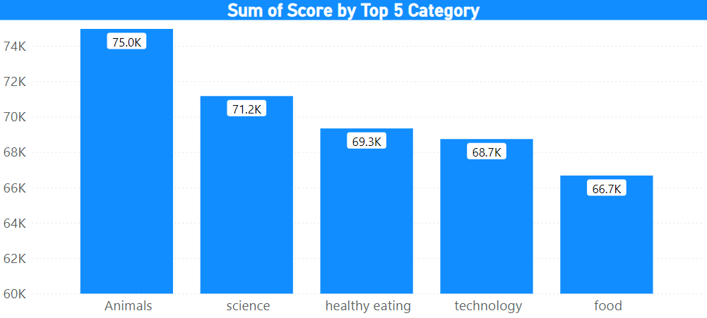
Top 5 most popular categories of content
Animals
Science
Healthy eating
Technology
Food

Slide 9
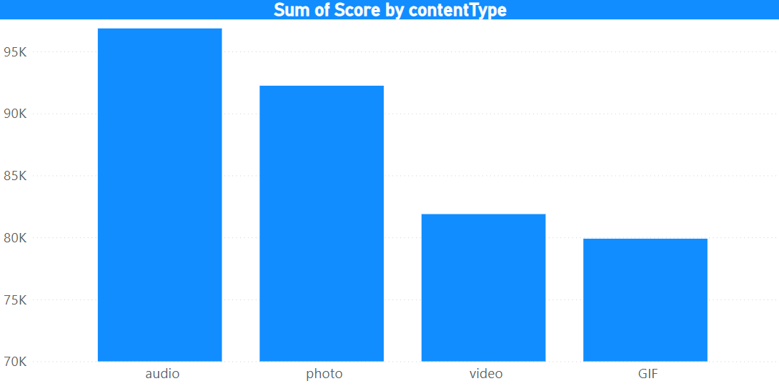
Highest ranking Content-Type
Audio
Photo
Video
Gif

Slide 10
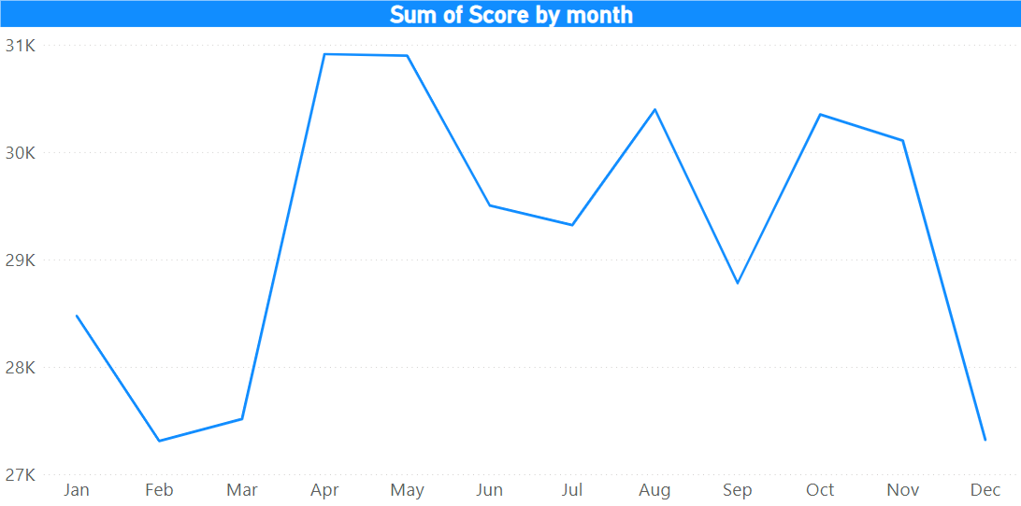
In what month High score reaction
May and April are
the highest scores

Slide 11


Analysis
Animals and science are the two most popular
Categories of content, showing that people enjoy “ real-life ” and “ factual “ content the most
Insight
Food is a common theme in the top 5 categories with “ healthy eating ”. This may indicate the audience within your base You could use this insight to create a campaign and work with healthy eating brands to boost user engagement
Summary
Next step
This ad-hoc analysis is insightful, but it’s time to take
This analysis of large-scale production for real-time
Understanding of your business. We can show you how
to do this.

Slide 12

Thank you!
ANY QUESTIONS?

